Slide 1
Ordered Indices
- Abburi Venkata Praveen

Slide 2
Why Indices?
In order to improve the speed of data retrieval operations on a database table.
Index is the best tool for the database to use to enforce uniqueness in data of a column.
Adding an index to a column will allow you to query based on a column faster.
Indices like primary key index and unique index help to avoid duplicate row data.
Improves the performance.
Indices offer substantial benefits when searching for records.

Slide 3
Types of Indices
Primary Index
Dense Index
Sparse Index
Secondary Indices

Slide 4
How Index works?
If we run any query in database first database will check to see if there is an index on the column(s) being queried.
When an index is used to fetch a row, the index is walked until it finds the row(s) of interest, and the base table is then looked up to fetch the actual row data.
When a row is inserted, a corresponding row is written to the index, and when a row is deleted, its index row is taken out.

Slide 5
Primary Index
A primary index is an index whose search key also defines the sequential order of the file.
Also Called a Clustered index.
he search key of a clustering index is often the primary key, although that is not necessarily
This helps improving the performance of queries using Order By and Group By, since the data rows are already sorted in the order of the indexes.

Slide 6
Secondary Index
Indices whose search key specifies an order different from the sequential order of the file are called Secondary indices.
Also called a nonclustering indices.
Index record points to a bucket that contains pointers to all the actual records with that particular search-key value.
This type of index does not alter and/or prescribe any sort of ordering of rows in the table.

Slide 7
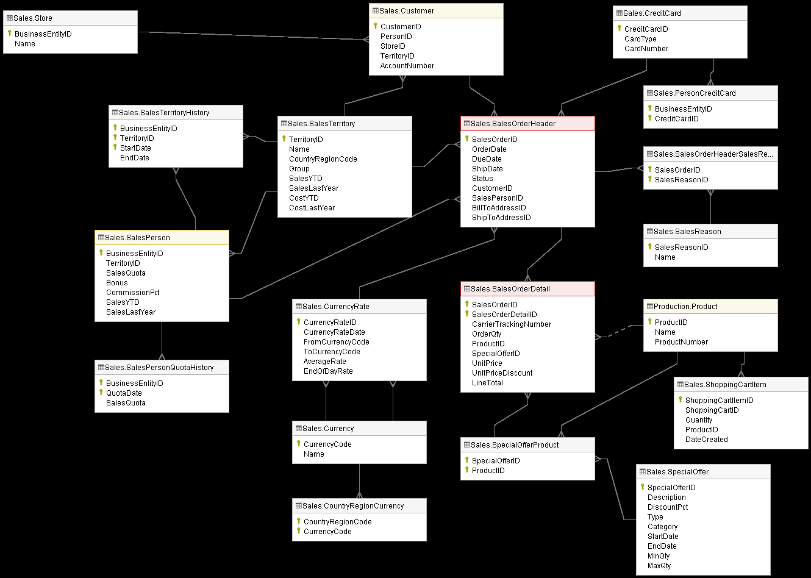
Data Set

Slide 8
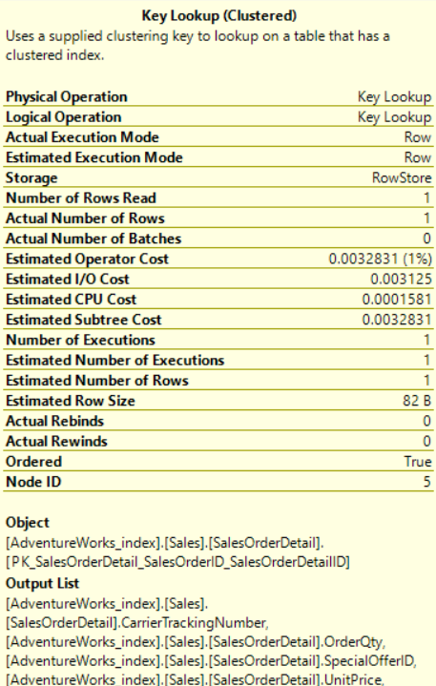
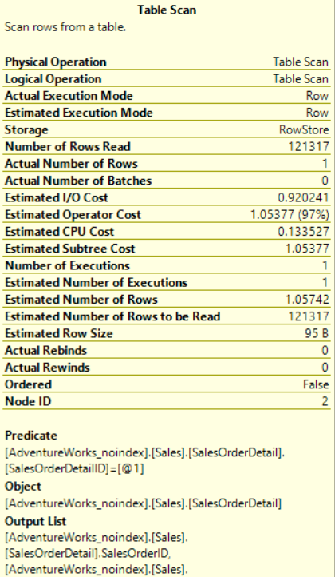
Clustered index & without index
Clustered Index without clustered index
Simple Query:
select * from sales.SalesOrderDetail where SalesOrderDetailID=121317;

Slide 9
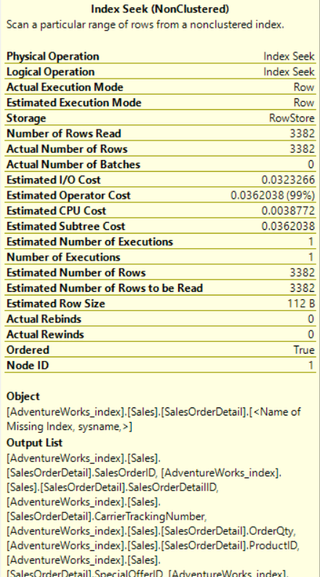
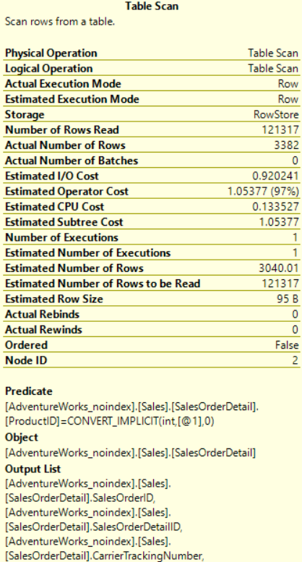
Non Clustered index & Without index
Non-Clustered Index without Non-clustered index
Q:select * from sales.SalesOrderDetail where ProductID=712;

Slide 10
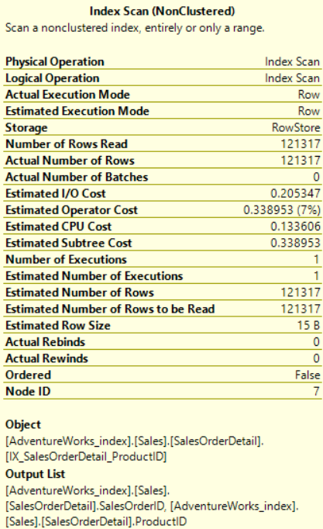
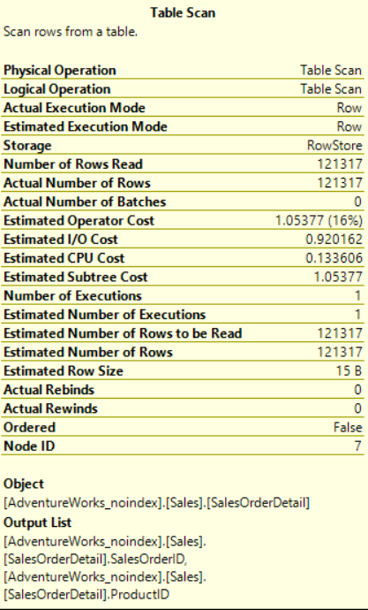
Non Clustered index & Without index
Non-Clustered Index without Non-clustered index
Complex Query:
SET STATISTICS IO ON
GO
SELECT Customer.CustomerID,SalesOrderDetail.ProductID,COUNT(*) as cnt FROM
Sales.Customer INNER JOIN sales.SalesOrderHeader
ON Customer.CustomerID=SalesOrderHeader.CustomerID INNER JOIN sales.SalesOrderDetail ON
SalesOrderHeader.SalesOrderID=SalesOrderDetail.SalesOrderID GROUP BY customer.CustomerID,ProductID having COUNT(*)>2;

Slide 11
Logical reads:
For clustered index:
For no index:
For non clustered index:
For no index table:

Slide 12
Analysis b/w index and with no index
From the above slides 8,9,10&11:
The number of rows read is low compared to no index table.
In the clustered & non clustered index table I/O, operator & CPU cost is less compared to no index table.
In clustered & non clustered index scan is done at index level where as in no index scan is done at table level.
Logical reads also low in indexed tables which can reduce the memory utilization while executing the queries where as no index table has more logical reads.
From the above assumptions creating indexes can make queries more efficient.

Slide 13


